Slide 1
My internship experience
Intern : Moaz Osama

Slide 2

My experience
During my summer internship at this company, I gained hands-on experience working with real-world data, utilizing advanced tools, and applying analytical techniques. This opportunity allowed me to strengthen my technical skills, collaborate with industry professionals, and deepen my understanding of data-driven decision-making processes.

Slide 3

Data Analysis

Slide 4

This experience solidified my passion for data analysis. It confirmed my decision to pursue this field long-term, as I found great fulfillment in uncovering insights and making data-driven contributions to decision-making processes. I am excited to continue growing in this area and advancing my career in data analysis

Slide 5
Enhanced Communication Skills with Stakeholders
Increased Professionalism in the Field of Data Analysis
My Expectations
Broadened Technical Skillset
Stronger Problem-Solving Abilities

Slide 6
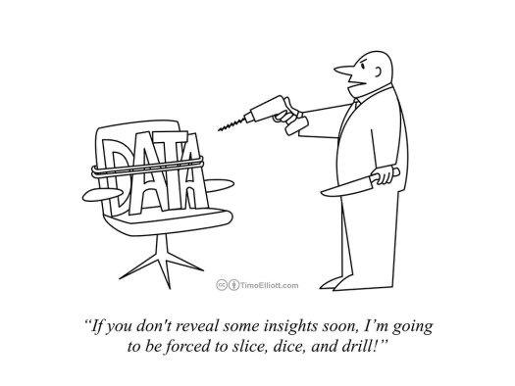
Soft Skills
I also enhanced my soft skills, such as communication, teamwork, and problem-solving, stubborn by collaborating with cross-functional teams and presenting insights to non-technical stakeholders. This experience helped me grow both professionally and personally

Slide 7

THANKS!
Any questions ?
___

Slide 8
Please, keep this slide for attribution.

